Slide 1

Journalism
An IT infrastructure for journalists

Slide 2
Contents
Why this project?
Architecture
Database
REST API
User Interface
Server
Usage
Conclusion

Slide 3

Why this project?
A changing world
Aternative media
Citizen journalist
Small teams
Lack of technical solutions

Slide 4
Architecture

Slide 5


Database
PgAdmin4
Open source
PgAdmin web server
3 tables
Users, jwt, articles
2 Docker containers

Slide 6
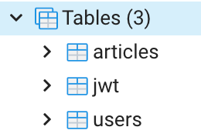
Database

Slide 7

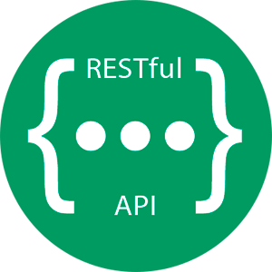
Rest API
Node.js
Express.js
Data Access Object
HTTP
Restfull
Jwt
Stateless
Hash (bcrypt)

Slide 8


User interface
React.js
Nginx
Tailwindcss
Login + Register
CRUD (Create, Read, Update, Delete)
HTTP header: Jwt
Local storage

Slide 9


Server
Next.js
Taiwindcss
Home, article, author
No auth

Slide 10
Architecture

Slide 11
Usage

Slide 12
Conclusion
Use the infrastructure
Host with us to reduce costs
Contribute to the code

